Slide 1
A&E Summit – Sony DADC services
Chris Reiser | Feb. 1st, 2011
Security Classification: Confidential

Slide 2
s
What services can Sony DADC provide to you?

Slide 3
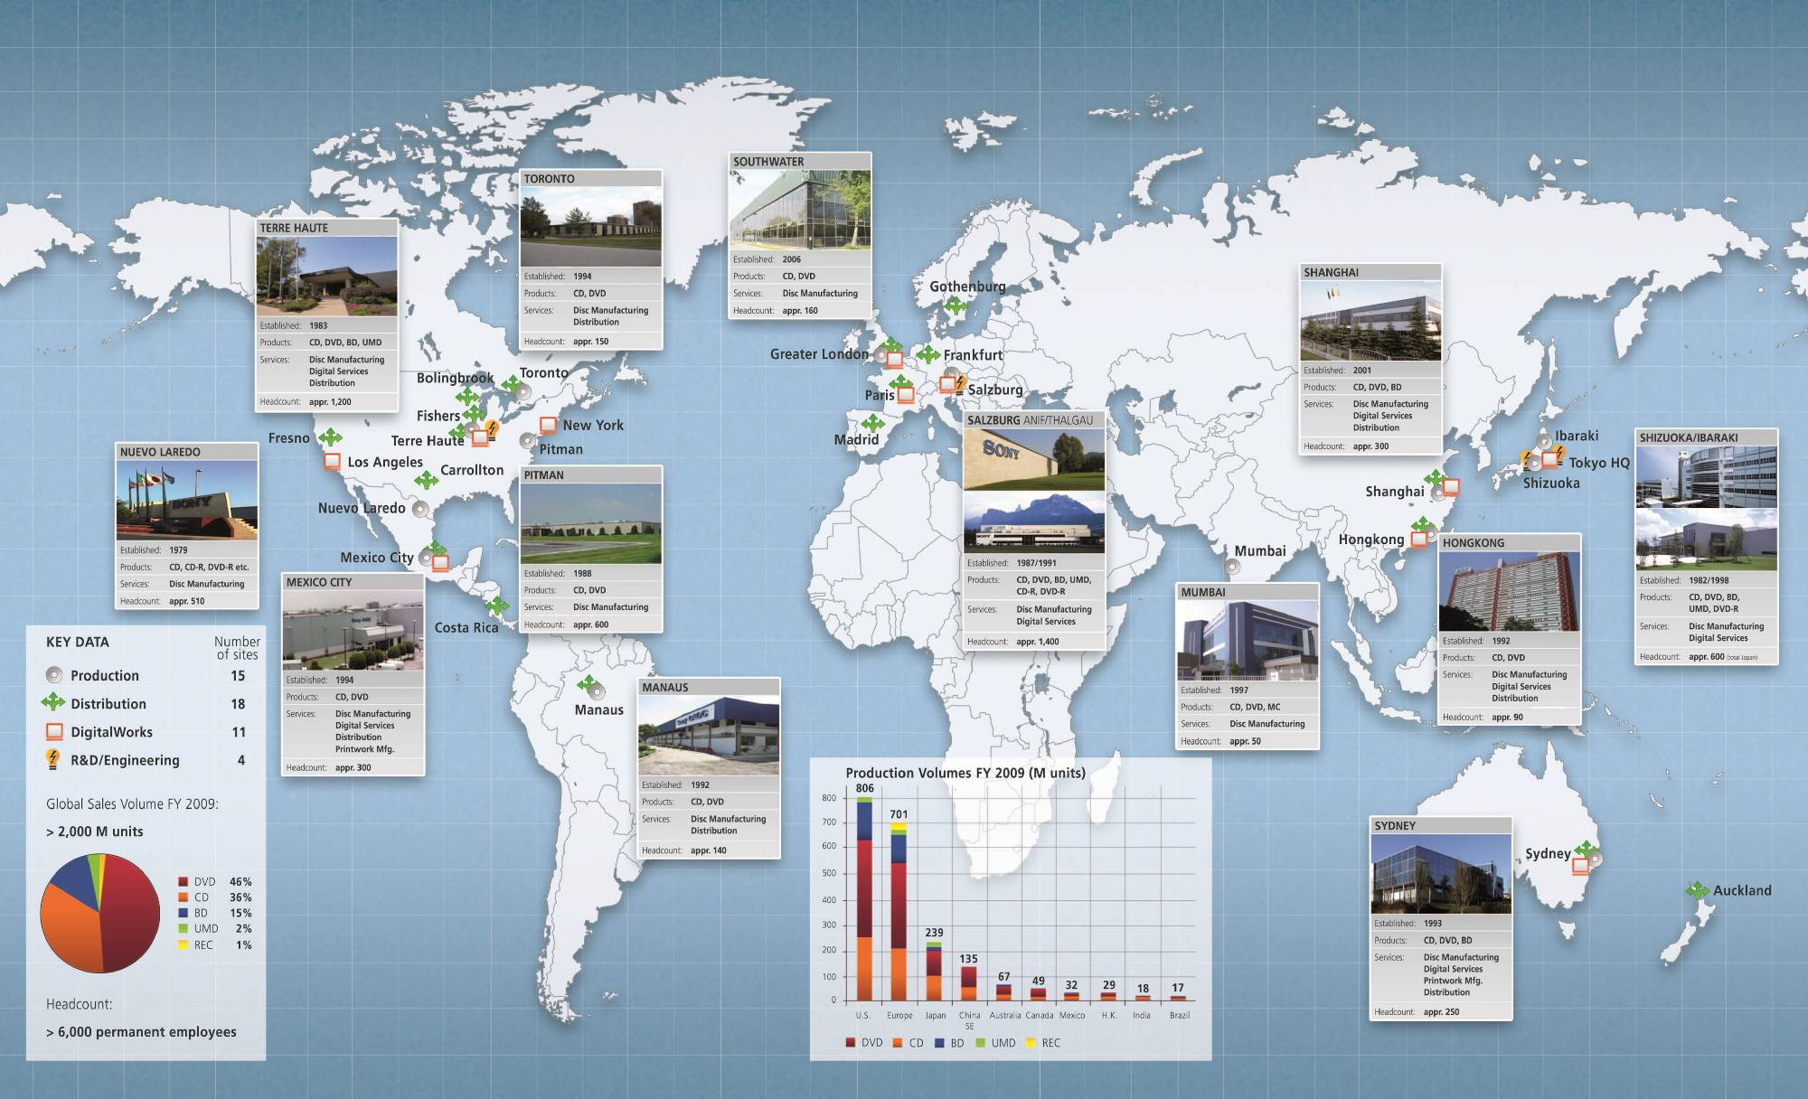
A Corporation sells in 150 countries and Sony DADC International’s Footprint – a good match
RUSSIA:
Legal Entity Nov. 2008
Customer Service at Local Office
Acquisition scheduled for April
Hong Kong
Service Hub for S/E Asia
Moscow
Pilsen
EUROPE:
Cz service center Pilsen
SRS retail services
AUSTRALIA / NZ:
BD Mastering June 2010
Full Supply Chain
Order to Cash Australia and New Zealand
INDIA:
New Plant Jan. 2010
BD capability Jan 2011
Distribution Services established
Security Classification: Confidential

Slide 4
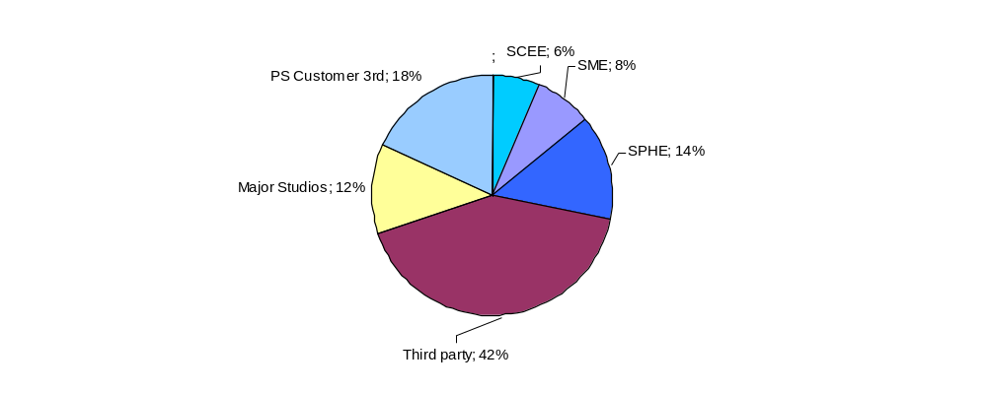
Sony DADC revenue portfolio shows a strong commitment to the industry
Non Sony business
of 54%

Slide 5

Capacity, services and global coverage support Blu-ray format roll-out
Peak Capacity Europe Nov.10: 30 Mil. Units Nov.11: 36 Mil. Units | Services Authoring Replication 3D support QC Packaging Distribution | Blu-ray roll out Europe China Australia India Russia (to be installed)
Security Classification: Confidential

Slide 6

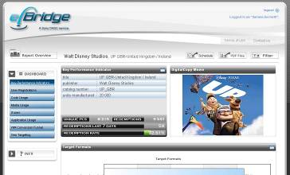

Digital Copy capabilities and Movie Code unlock revenue streams in the Covermount business
Electronic serial key (Postscribed IDTM) instead of
serialized printwork or sticker for seamless activation
  Maximum consumer convenience
  and hassle free re-orders
Sony DADC‘s Market Intelligence platform provides
instant end2end reporting of relevant information
  Digital Copy redemptions and format usage
  Geo Targeting
  User Registration
  Target Group Analysis
Template based and customizable graphical
user interface
  Multi language capable
  Including registration forms
Support of all leading Digital Rights Management
solutions

Slide 7



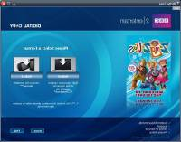
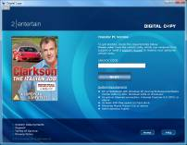
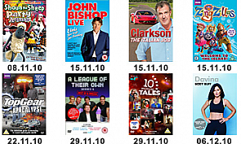
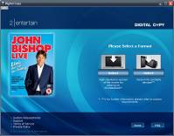
----- released 8 titles with
Client: 2entertain / BBC
Problem / pain:
- Slowly declining market size for packaged media.
Erosion of customer perceived value.
Need to add value and position of BBC / 2e titles.
Solution:
- Digital Copy on 8 new titles for pre-Christmas release (total 1,5M units).
3 x digital copy files per title – WMV (high res & low res), MP4 (low res).
Weblink to BBC Online Shop.
- On-pack stickers, on-pack instructions, explanatory leaflet insert.
Goal:
Consumer added value – introduction to digital video.
Reposition brand as leading edge – forward thinking.
Capture consumer registrations and market intelligence with PID+Analytics.
Additional strategic reasons:
- Paul Dempsey (new CEO) driving new business
Results per 31.1.2011
Based on the sell through rate:
the average unique visitor rate of all titles is 2,7%
more than 75% of these visitors registered for further information and promotion material
more than 60% transferred a Digital Copy to their devices
the average return rate by a unique visitor is 2,5!

Slide 8


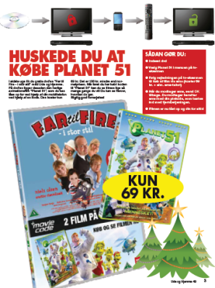
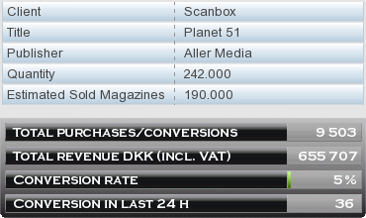

Using magazines & newspapers as a new retail channel by distributing MovieCode movies on magazines
Movie Code for Aller Press
Results per 31.1.2011
Client: Scanbox Entertainment
Distribution channel: Aller Press (largest magazine publisher in Denmark)
Magazine: Ude og Hjemme – Weekly magazine (Target group ”Young family”)
Circulation: 250.000
Release: 1.12.2010
Two movies on one disc (DVD9)
Packed in Thin Pack DVD box - Cover 4+4
First movie for free - “Far til fire”, famous Danish family title
Second movie - “Planet 51” -Unlock price DKK 70 (~9,4 €), charged to the consumers phone bill
Unlock price 4€ below retail version
Launched parallel to movie 2 going from “new release” to “catalogue” in retail
PR campaign: Add in the week before, TV spots when launched, 4 page insert in magazine, after campaign in week after (to increase after sales)
Sony DADC sales price: Disc prices as per the agreement, MovieCode surcharge and revenue share from the net telco payout rate
We reached additional revenue of 87k EUR for the second movie on the disc in the first six weeks since 1.12.2010
We reached break even for all parties
Aller Media sold more magazines compared to other own Covermount releases
No consumer claims regarding technical aspects
We will launch a second payment method called IVR (interactive voice response) with the next titles. Consumer can choose to either call a number or send a SMS to purchase the pincode
Aller Media ordered upcoming Movie Code Covermount titles starting week 14 in 2011
Scanbox ordered additionally to the current Movie Code Retail title “Centurion / Doomsday” released on 6.12.2010 in 4 countries (Dk, Fi, Se, No) a second Movie Code Retail title which will be released week 6 in 2011.

Slide 9
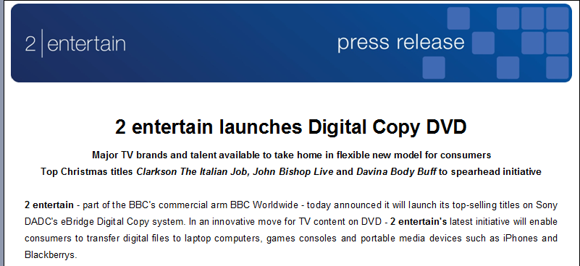
BBC using eBridge for digital copy on high profile title
Security Classification: Internal Use Only

Slide 10
European Supply Chain strength & strategic positioning
Entertainment market is our core business with manufacturing services, distribution services, IT & financial services, digital services, retail services (orderdesk & cash collection) and direct to consumer .
Full ownership for operation in the European territories, including IT, KPI management and European supply chain improvement program.
One IT solution for European supply chain management
(5 DC, 3 factories)
Market oriented position of our distribution locations, close to carrier hubs and central retail warehouses, more than 2/3 of the European market is within 100 km reach of our DCs.

Slide 11







Sony DADC – European Supply Chain Network
Vendors
Plants
DCs
Customers
Anif, Thalgau
Madrid
Polycarbonate
Paris
Print
Southwater
Enfield
Southwater
Gothenburg
Cases
Frankfurt
Cartons
Czech Service Center (Vimperk & Pilsen)
Milano Service Office
Security Classification: Confidential

Slide 12
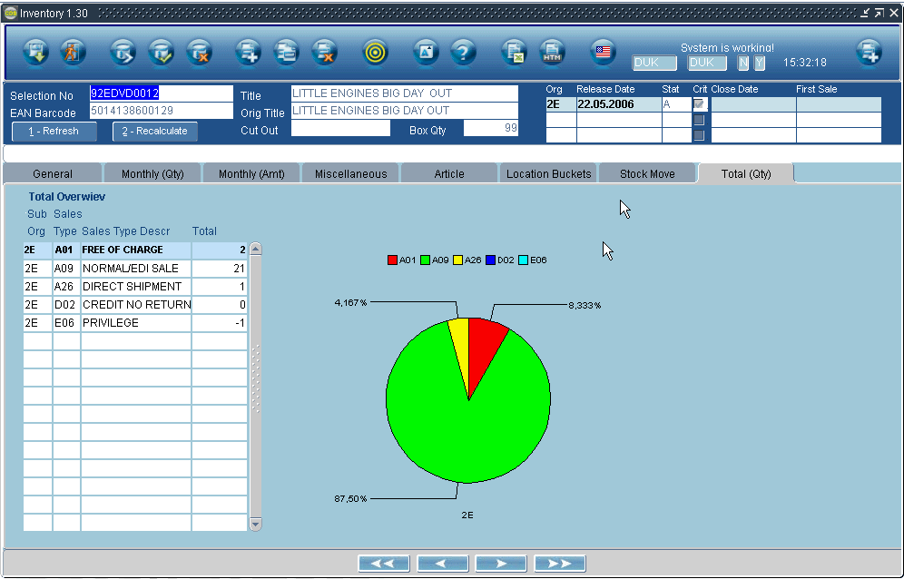
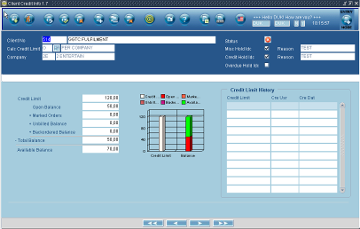
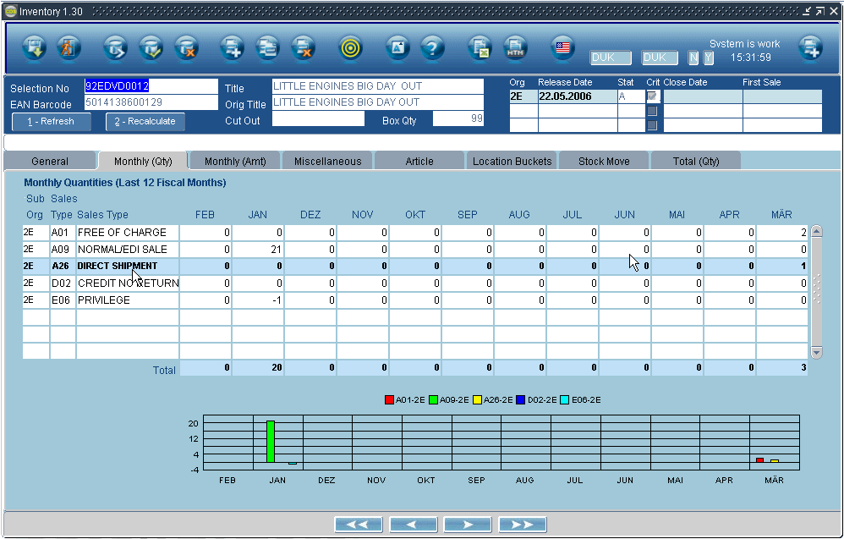
CDS – Common Distribution System
Sony DADC’s distribution
solution for the
entertainment industry
Key Facts
yearly, more than 1100 users
185m units shipped paneuropean
19m order lines (up to 90% EDI)
3m return lines processed
Oracle Database, Oracle GUI (web enabled)
access through web browser
e-mail & fax & excel integration

Slide 13
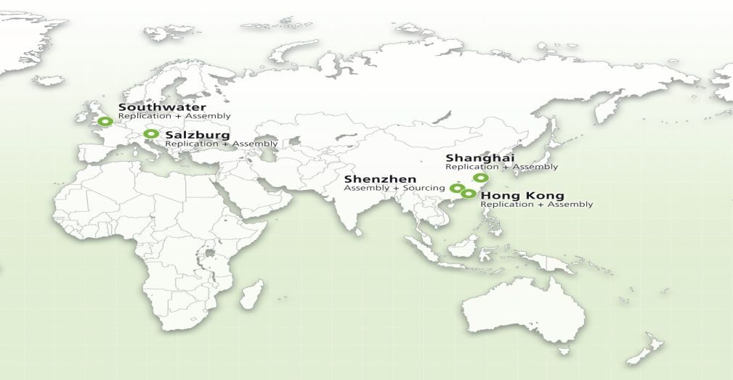
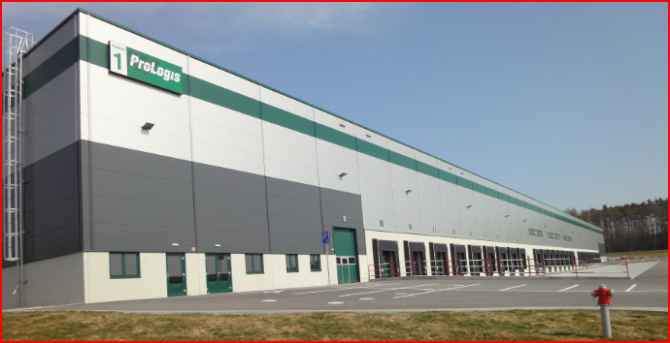

Service Centre Czech for Assembly operation combined with China sourcing creates a competitive special packaging scenario
Sony DADC Service Centre Pilzen
Total Area: 17.000m²
Close to Western Europe markets
Services
special packaging operation
centralised returns turnkey solution for continent
China sourcing office
Lower Cost, longer turnaround
Flexibility and customized products
Standard suppliers are Green-Partner certified
Products Metal cases, wooden cases, Hardcover books and boxes, promotion Articles

Slide 14




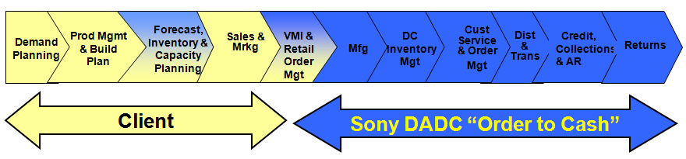

Sony DADC services support a successful go to market strategy for Home Entertainment

Slide 15
Backup
Security Classification: Internal Use Only

Slide 16
MovieCode offers new revenue windows for packaged media
Sell Through
DVD/BD
Rental
DVD/BD
VoD,PayTV
Digital
TV
Digital
Traditional windows
Theatrical
Mass exploitation of back catalogue through magazines
Covermount
Mass exploitation of back catalogue utilizing magazines as distribution channel
Part Works
New Revenue Window for packaged media utilizing movieCode
Locked
promotional
trailers
Locked
additional
content
Locked
expiring
content
Full
circulation
exploitation
Locked
additional
content
Security Classification: Confidential

Slide 17



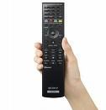



MovieCode offers new opportunities to exploit the catalogue
Distributed via Magazine or as second disc in Block Buster releases
Additional movie content
unlocked by MovieCode
Click to
see the movie
Click to unlock
First MIB movie.
Price 5,99 €
Click to
see the movie
Block Buster revenue model: Catalogue exploitation inside Block Buster releases
Covermount revenue model: Catalogue exploitation as part of covermount
Security Classification: Confidential

